Slide 1
BREAST CANCER PREDICTION
Using MACHINE LEARNING ALGORITHM

Slide 2
Group By: ANKUSH AAKASH DEEP TUSHAR CHOUDHARY SATYAM KUMAR AMAN AANCHAL ASSIGNED BY: ANCHAL SINGH

Slide 3
BREAST CANCER
Breast cancer is a cancer that develops from the breast tissue.
Breast cancer is a disease in which malignant(cancer) cells from in the tissue of the breast.
When a tumor is diagnosed as benign, doctors will usually leave it alone rather than remove it

Slide 4
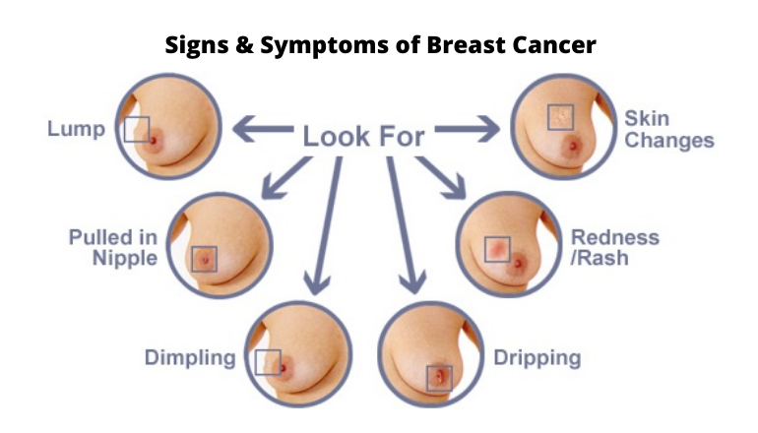
Symptoms and Signs

Slide 5
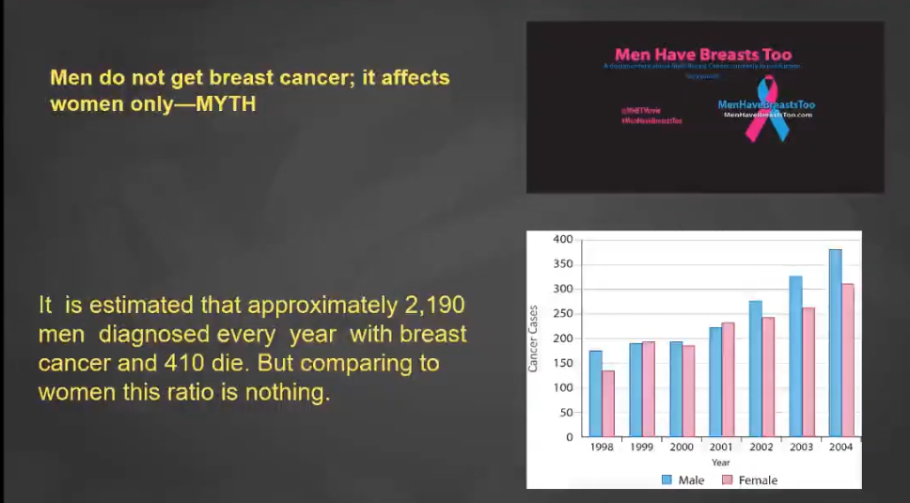

Slide 7
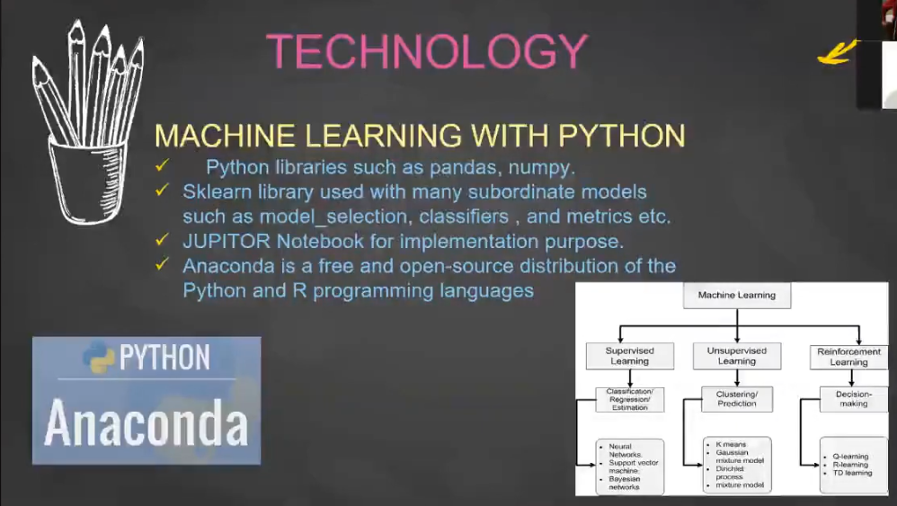

Slide 8
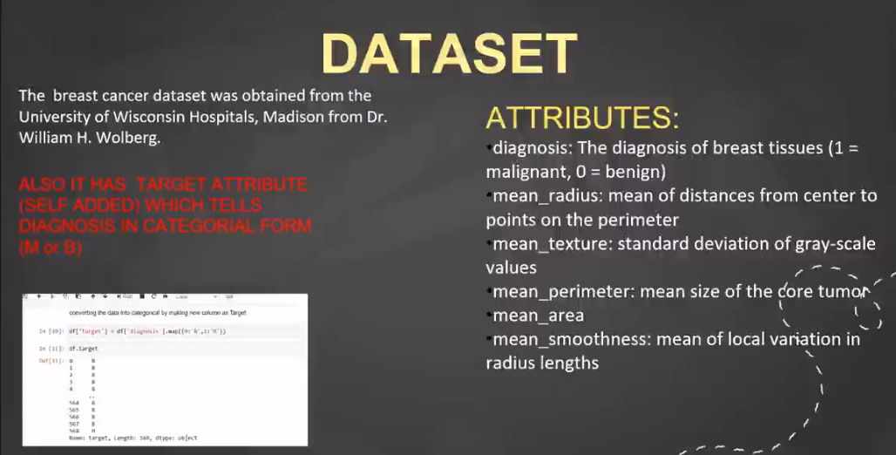

Slide 9
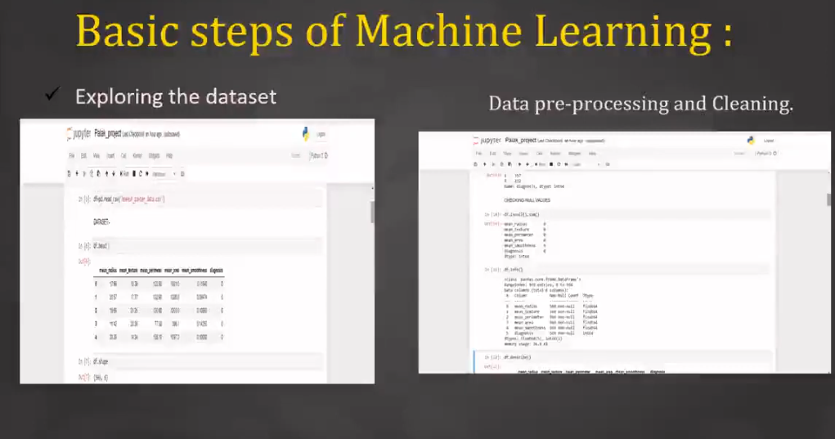

Slide 10
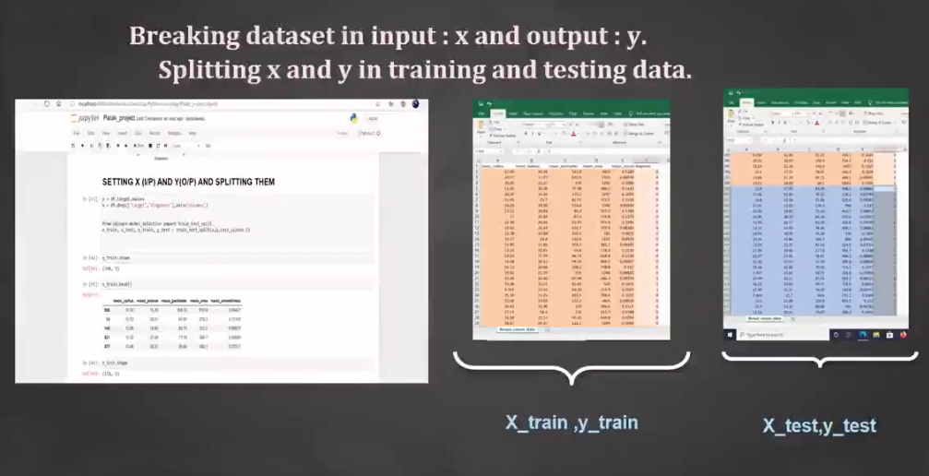

Slide 11
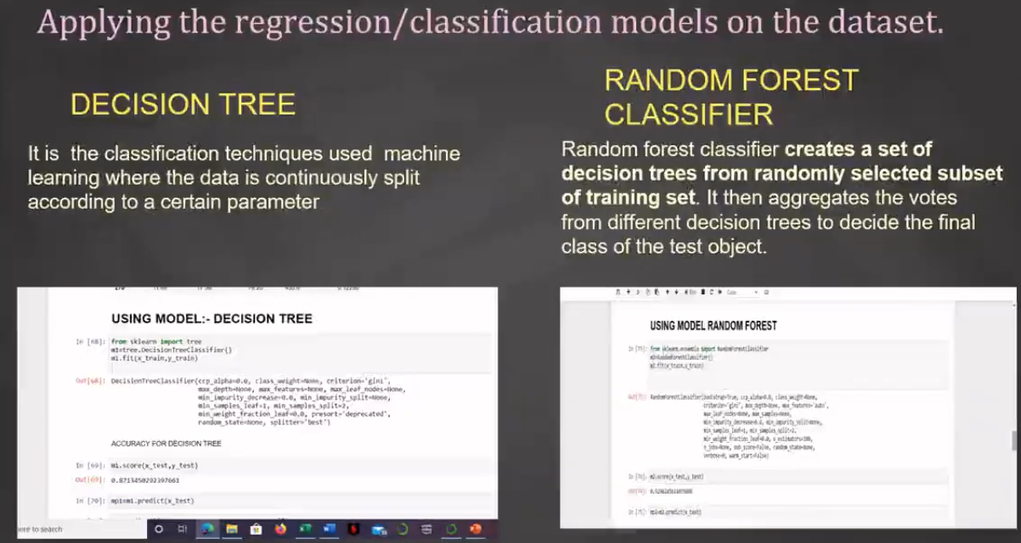

Slide 12
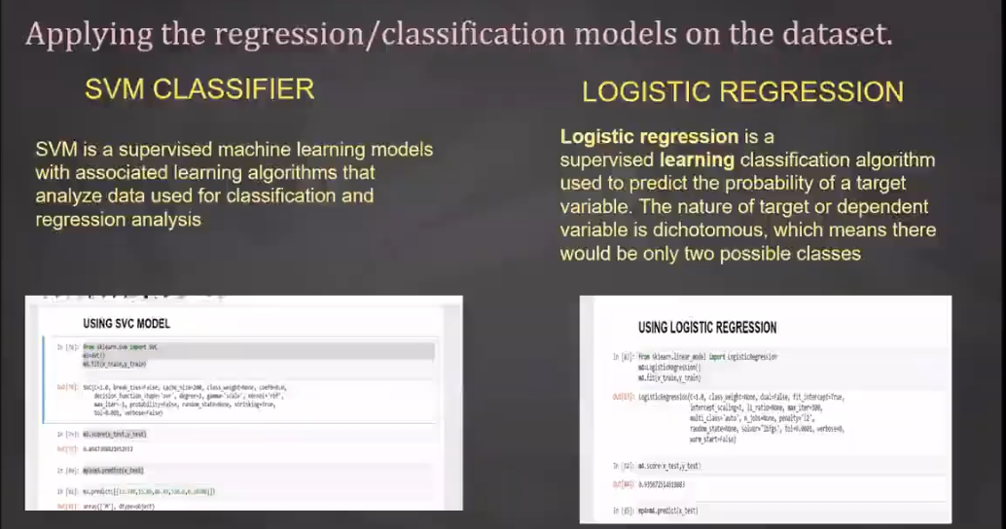

Slide 13
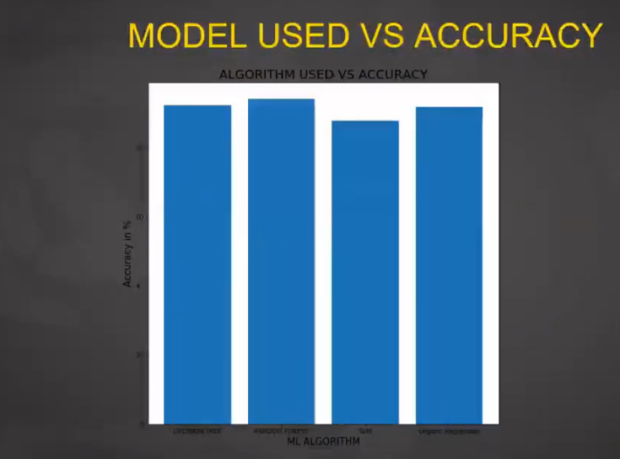

Slide 14
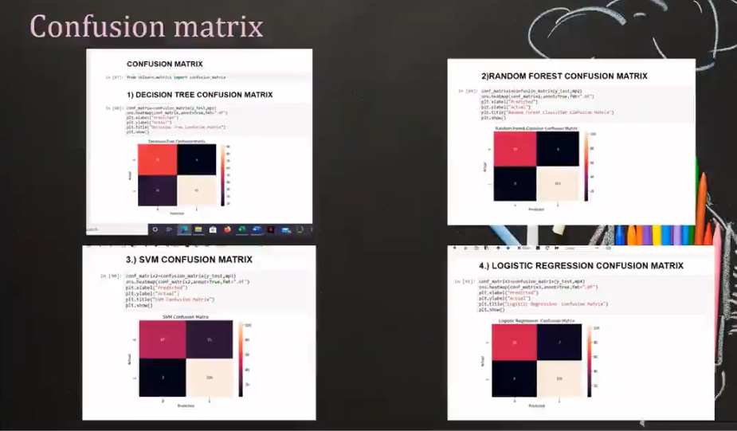

Slide 15
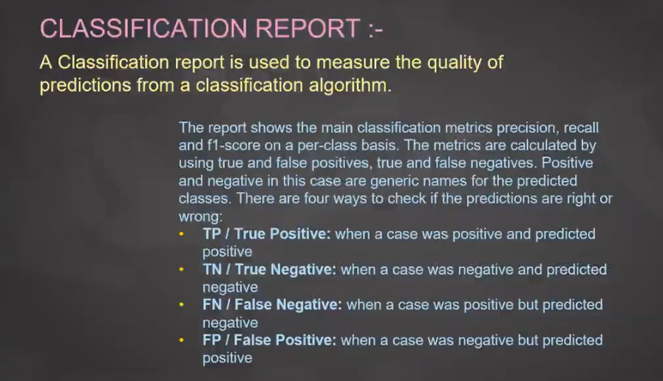

Slide 16
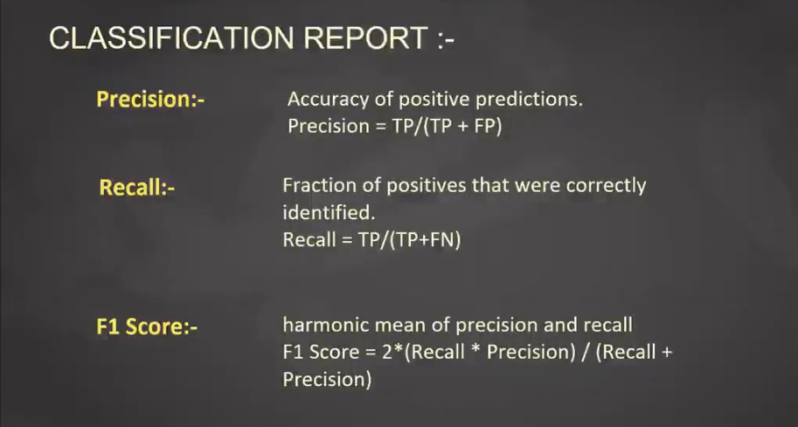

Slide 17


